Slide 1
Welt-Simmental-Fleckvieh Federation 50th Anniversary 1974 - 2024
24th Regular members meeting
July, 29th 2024
Calgary, CANADA
Richard Pichler
Georg Röhrmoser
Josef Kucera

Slide 2
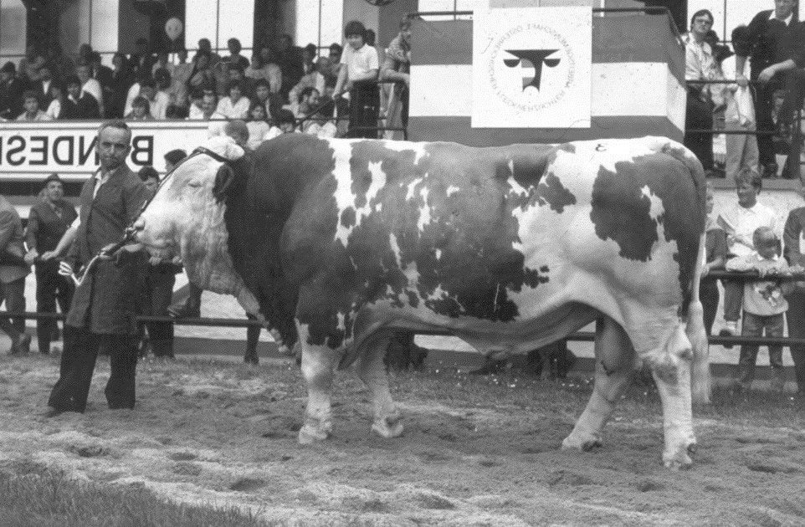
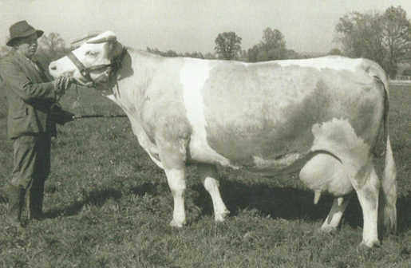
Let's look back
1962 - Foundation of the European Simmental Cattle Association in Munich
1968 - First discussions on the foundation of a world association
1972 - 10th EVF Congress in Munich - Decision to form a world association
MORELLO, OÖ, AT
GZW. 111, MW. 101, FW. 104,FIT. 115, MB .93
Breeder Josef Kirschsteiger and his Viktoria, the first winner of the Dr. Anton Pohl Prize (lifetime yield 104,854 kg milk, 4,465 kg fat)

Slide 3
1974 Zagreb, Yugoslavia 11th ESF General Assembl
Representatives from 20 countries were present:
Argentina, Australia, Austria, Brazil, Bulgaria, Canada, Czechoslovakia, France, Germany, Great Britain, Hungary, Iraq, Iran, Italy, Yugoslavia, New Zealand, South Africa, Switzerland, Uruguay, USA

Slide 4
The most important objectives according to the Statutes
Cooperation between the breeders' organizations
Development of common breeding rules
Exchange of information
Making pedigree certificates and performance results comparable
Guidelines for the recognition of pedigree certificates
Promotion & publicity

Slide 5
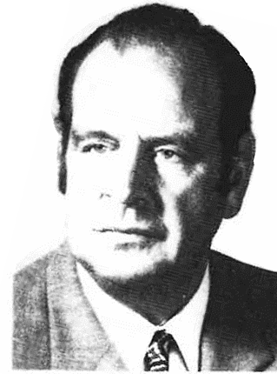
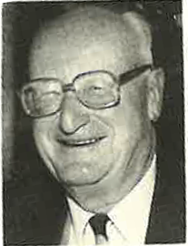
1976: 1st World Congress Pretoria, South Africa 16 countries from Africa, Europe, Oceania
Presidency: Ernst Senckenberg, DE (left)
Jerry Moore, USA Richard Vincent, AUS
Secretary General: Dr. Ernst Jenni, CH (right)
Topic: Simmental-Fleckvieh (Si-Fv) in extensive use for prairie and scrubland and in intensive farms with dual use

Slide 6
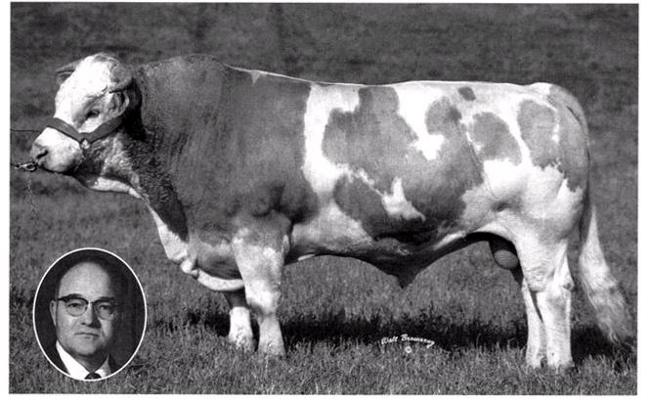
1978: 2nd World Congress Calgary, Canada Participation 19 of 20 members
New Secretary General: Alfred Rüegsegger, CH
Topics:
Setting up the working groups on finance, polled cattle breeding, conformation defects
Large-scale beef cattle breeding
World market for beef
In 1967 Canada imported
the Si-Fv bull PARISIEN No. 1 from France.

Slide 7
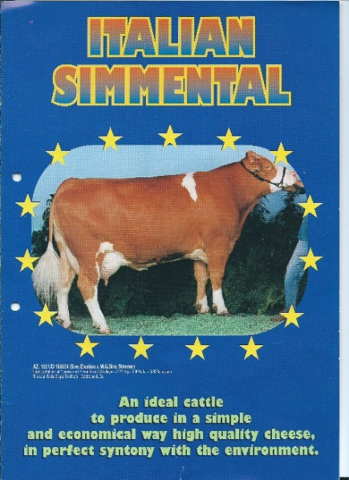
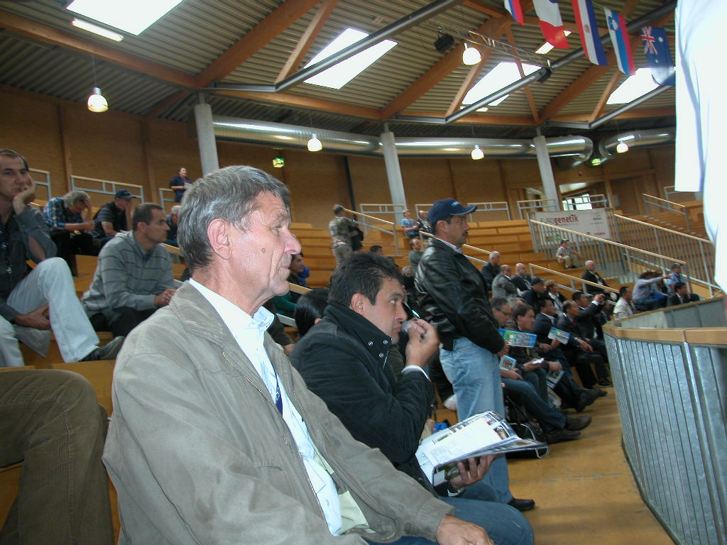
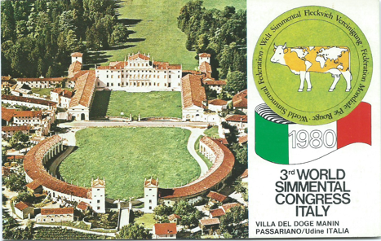
1980: 3rd World Congress Venice, Italy 18 member countries
20 years of the Italian national association A.N.A.P.R.I.
Topics:
Fattening performance experiments with purebred and crossbred animals in Italy
Villa del Doge Manin, Friaul

Slide 8
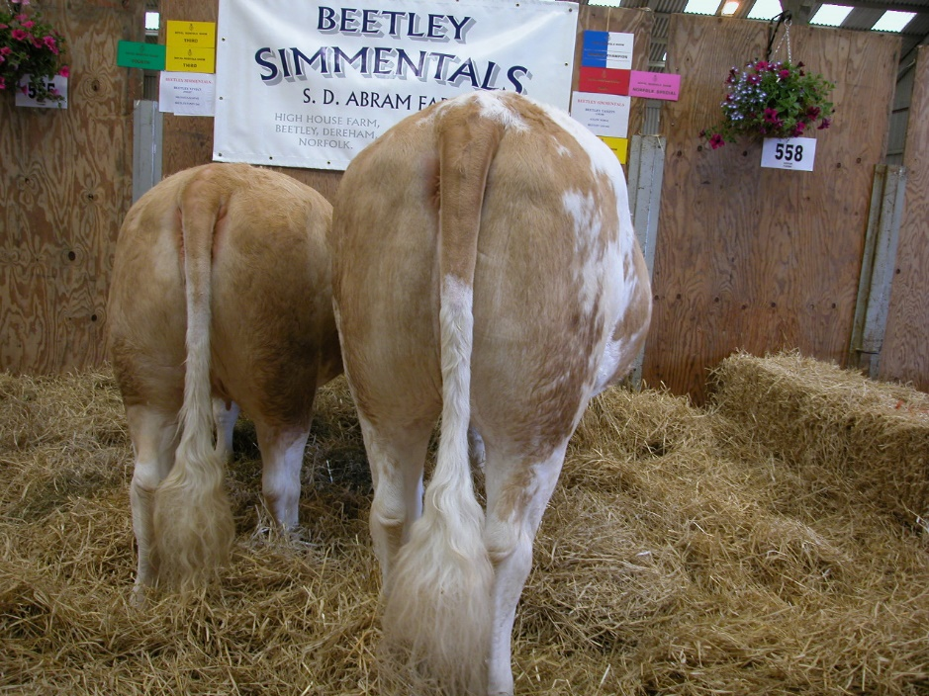
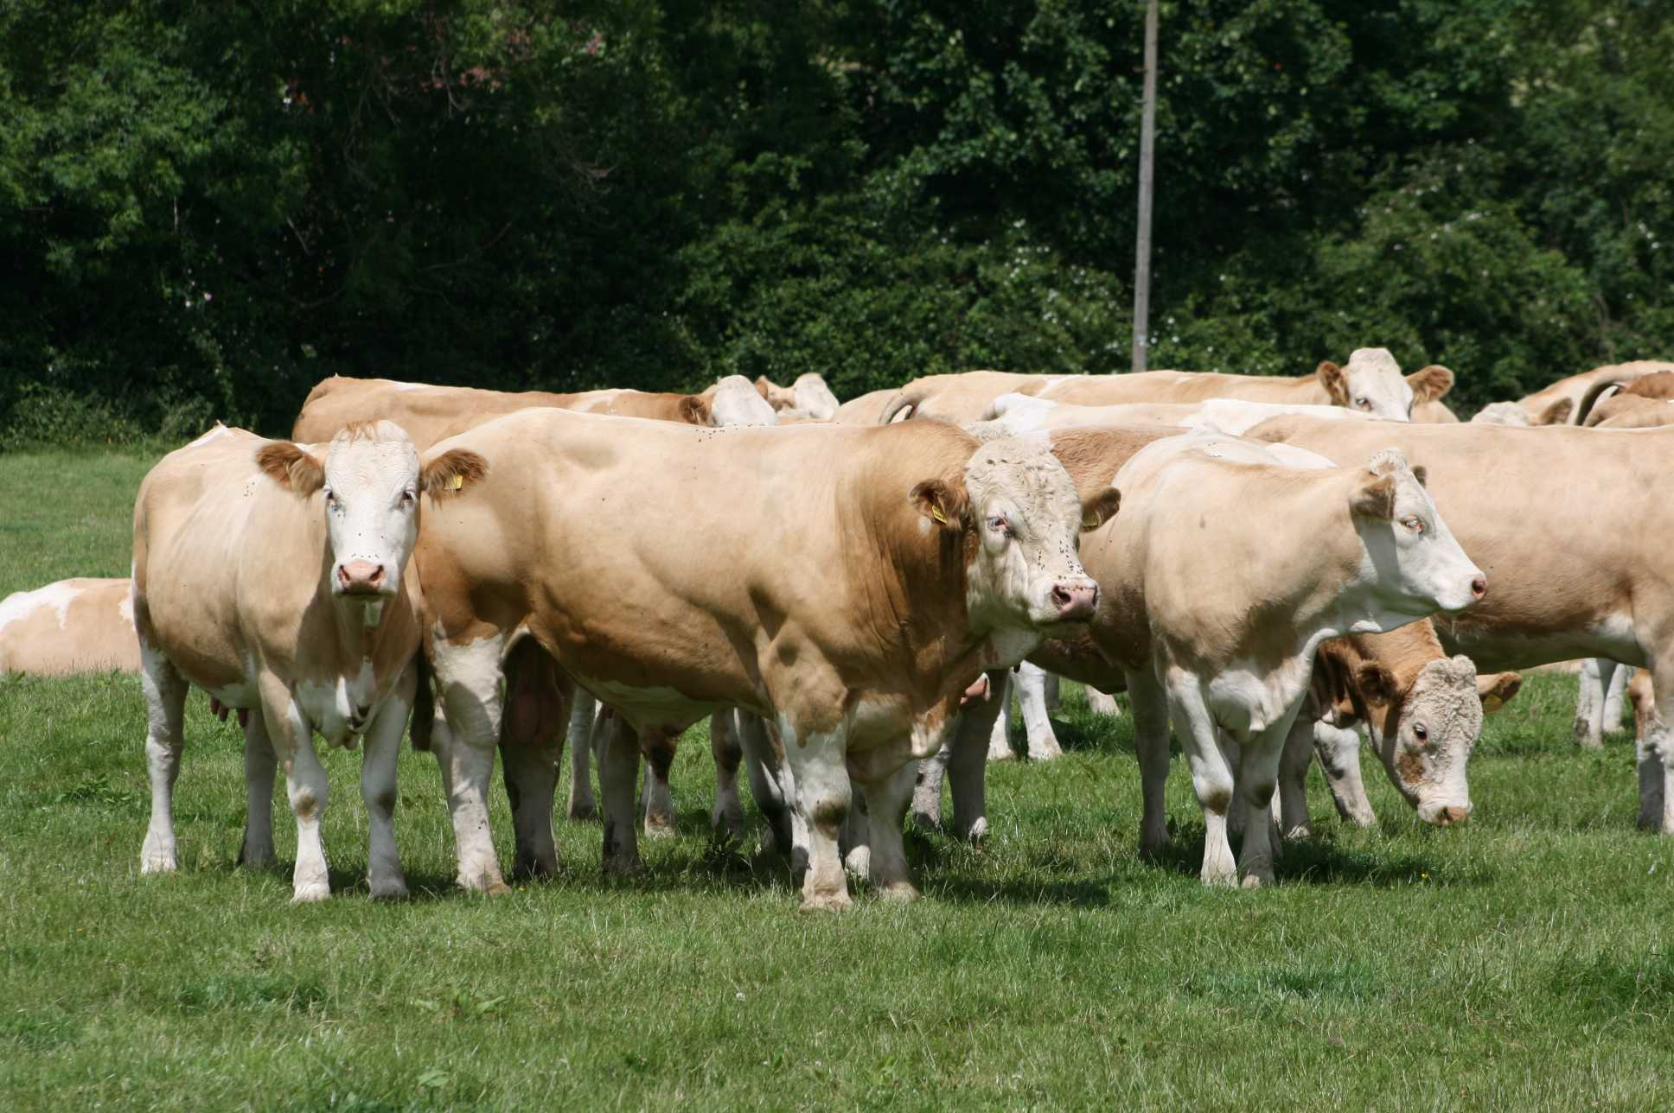
1982: 4th World Congress, Edinburgh, UK 15 member countries
Topics:
Embryo transfer, cloning
best suitability for crossbreeding in suckler cow herds
excellent showmanship

Slide 9
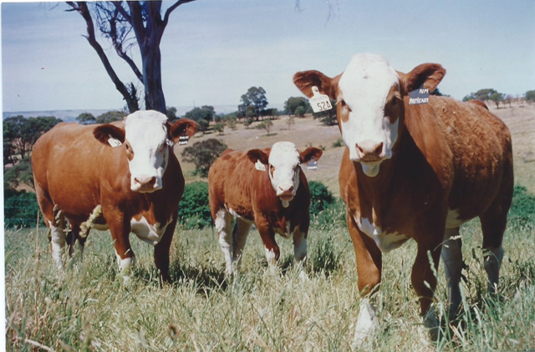
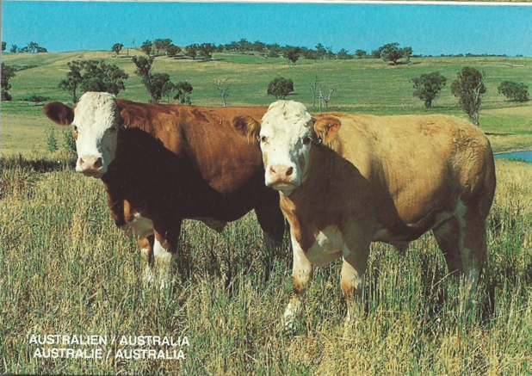
1984: 5th World Congress Sydney, Australia 12 of 19 countries present
Topics:
Extensive working group meetings
Si-Fv ideally suited for forage conversion and grassland use
700 herdbook breeders with 80,000 animals in Australia

Slide 10
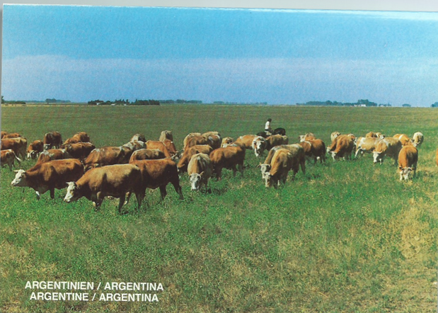
1986: 6th World Congress Buenos Aires, Argentina
New Presidency:
Pedro de Ocampo, ARG
Dr. Otmar Föger, AT
Lloyd Powell, USA
Topics:
Selection measures against parasites and heavy births
Commercial crossbreeding farms
Importance of the Si-Fv in South America
1922 first imports of Si-Fv animals
from 1967 larger imports

Slide 11
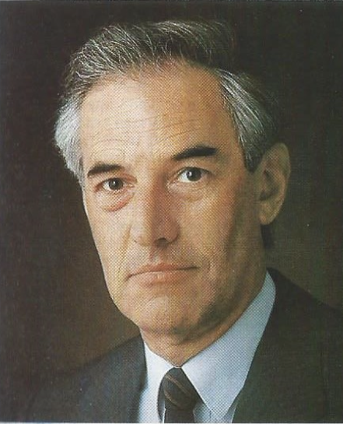
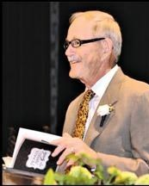
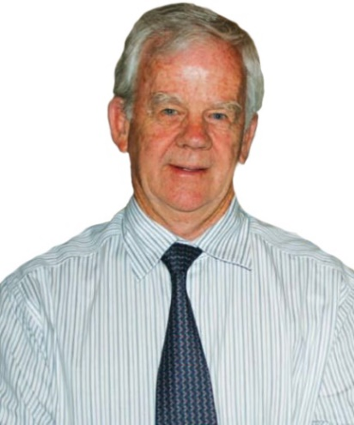
1988: 7th World Congress Munich, Germany 20 member countries Greetings from China
New Presidency:
Dr. Föger, AT Lloyd Powell, USA Peter Massmann, RSA
Topics:
Breed development and promotion
Breeding technique
Linear type description with color description

Slide 12
1990: 8th World CongressLausanne, Switzerland 20 member countries 5 new countries join
New Secretary General:
Niklaus Flückiger
The now 4 working groups meet
Finances and membership
Breed development and promotion
Breeding technology
Beef production
The Swiss Simmental Cattle Breeders' Association celebrates 100 years of existence.

Slide 13
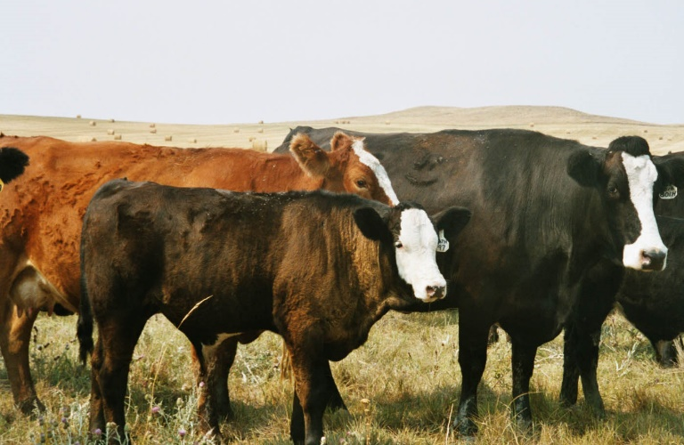
1992: 9th World CongressDallas, Texas 4 new member countries, bringing the total to 29
New Presidency:
George Anderson, UK; Hugo Valentin, IT; Brian Kitchen, US
Spanish becomes 4th congress language
Survey results: 105,862 farms, 18 million Simmental cattle in the 25 member countries
Importance of crossbreeding SIMBRA = Simmental x Brahman
Si-Fv x Angus - black color in Si-Fv breeding

Slide 14
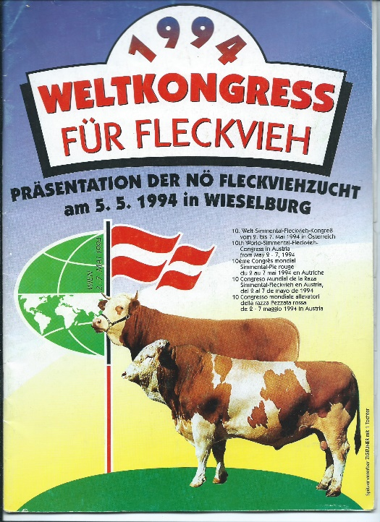
1994: 10th World Congress Austria 25 of 29 countries take part
New 2nd Vice-president: Andreas Weil, ARG
Topics:
Breed standard must be documented for Si-Fv: origin, basic coloration, color distribution, secondary performance traits, polledness
Dual purpose in family farms
Cooperation between science and practice: e.g. localization of the marbling gene
With 31 member countries and 3.5 million animals in its herd books, the WSFF is the largest global breeders' association.

Slide 15
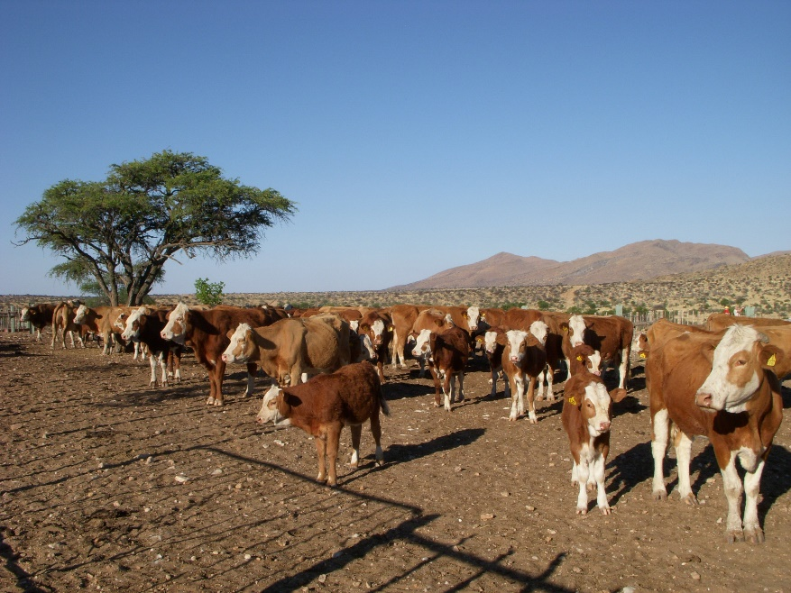
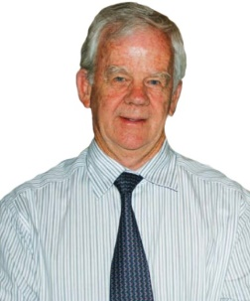
1996: 11th World Congress South Africa and Namibia
New Presidency Dr. Hugo Valentin, IT; Andreas Weil, RSA; Hans Häckel, DE
Best-attended congress with 500 guests from 24 countries (Roe Wiid, Peter Massmann)
Legendary statement: “You can produce milk without meat
but not meat without milk” (Peter Massmann)
Topics:
The focus is on Si-Fv in pure breeding and crossbreeding with Brahmans under extensive conditions
“Simmental World News” (June 1996)
Presentation of the SIMDEX system (reproduction index)

Slide 16
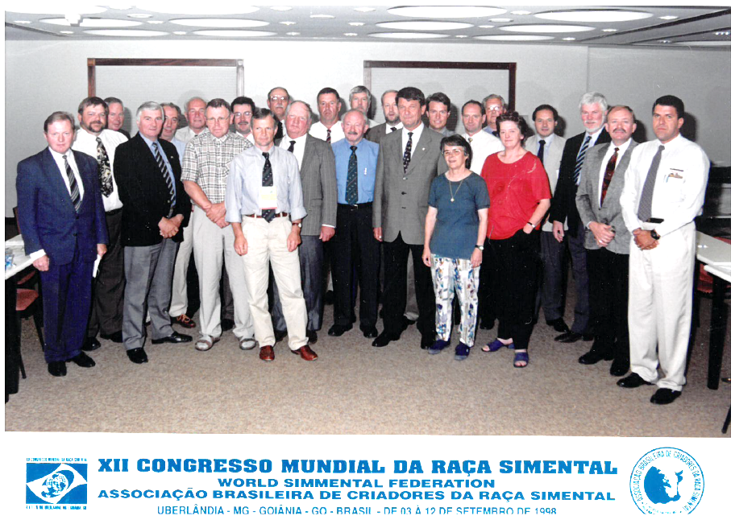
1998: 12th World Congress Brazil - Goiania, Uberlandia
New Presidency
Dr. Hugo Valentin, IT;
Hans Häckel, DE
new: Robert Haralson, USA
New Secretary General:
Yves Schleppi, CH
Topics:
DNA marker for polledness and parentage control
internal meat quality
Comparable breeding values for beef traits
Application of an overall breeding value (GZW) with the partial breeding values for milk, beef and fitness
SIMBRA breeders join the WSFV
Discussion Internet homepage

Slide 17
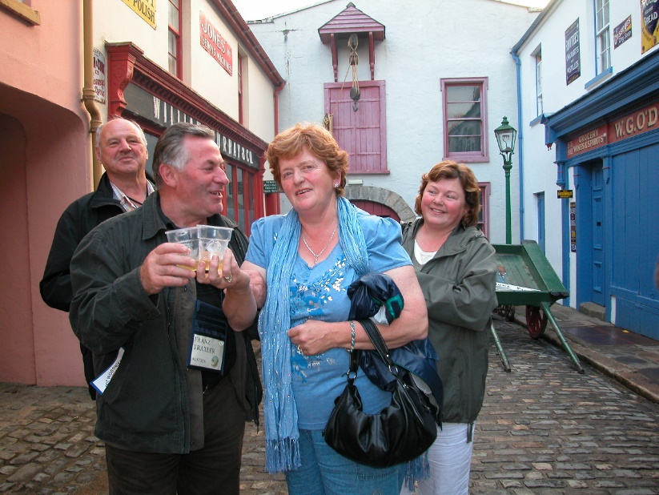
2000: 13th World Congress Kildare, Ireland 250 participants from 22 countries
New Presidency:
Hans Häckel, DE
Robert Haralson, USA
Eduardo Rosenberg, ARG
Topics:
New animal identification EU-wide
DNA markers
Lectures on beef performance testing according to ICAR
Advantages of Irish Simmental: calving ease, muscle development
Problems Si-Fv recognition in new countries
Practice exchange program for young Simmental/Simbra breeders
Franz Traxler, Alice Mullen

Slide 18
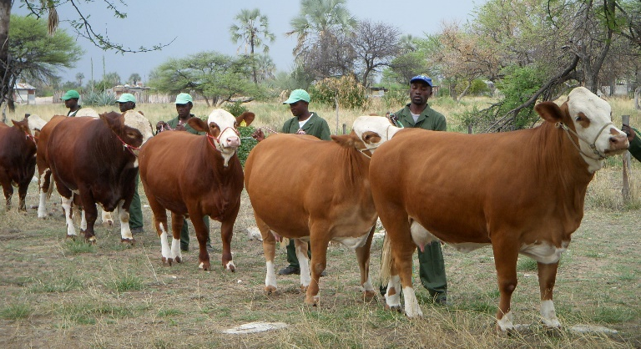
2002: 14th World Congress South Africa and Namibia worldwide animal disease crisis (BSE, FMD)
New Presidency:
Robert Haralson, US
Franz Stürzer, DE
Peter Speers, AUS
NewSecretary General: Andreas Bigler, CH
Topics:
“The dual purpose of the Si-Fv in European countries”
The beef utilization of the Si-Fv
New total breeding value (GZW) in DE+AT: 39:17:44 = milk : beef : fitness
Ecological benefits - less methane per kg milk and beef (Kräußlich)
4 presentations: Performance of Simmental in SA and NAM
Discussion marker-assisted selection (MAS)

Slide 19
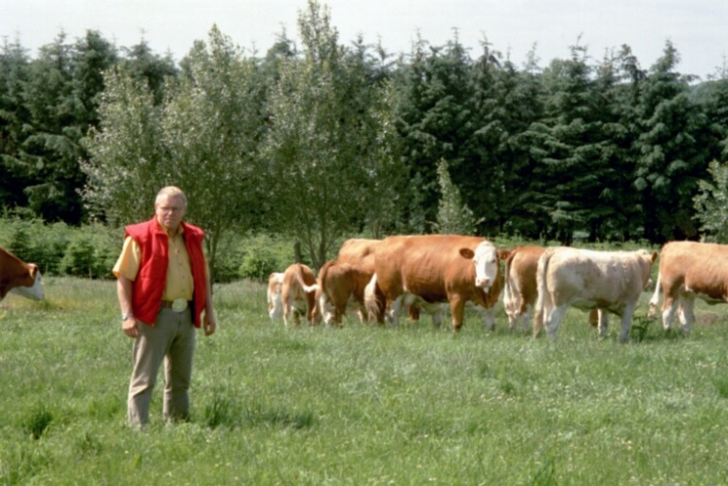
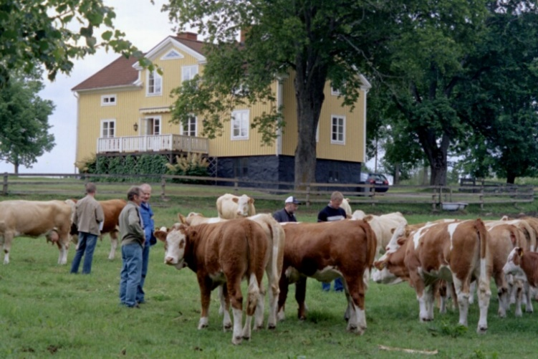
2004: 15th World Congress Aarhus, Denmark+ Tour to Sweden
New Presidency: Franz Stürzer, DE; Josef Kucera, CZ; Bruce Holmquist, CAN
Topis:
Linear type description in beef cattle breeding
Breeding technique: recording of hereditary defects, crossbreeding with Holstein
Purebred Si-Fv: maximum 12.5 % foreign blood
ZWS model “Breedplan” - 17 traits, worldwide application (Speers, AUS)

Slide 20
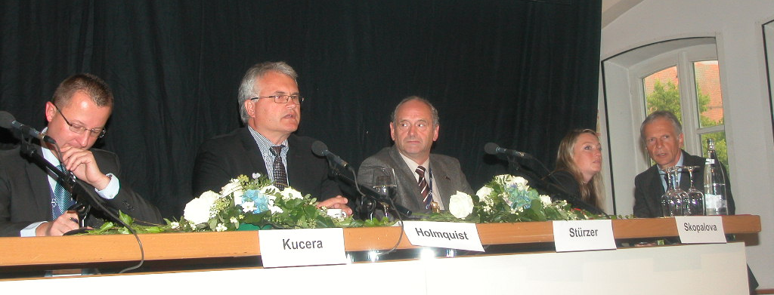
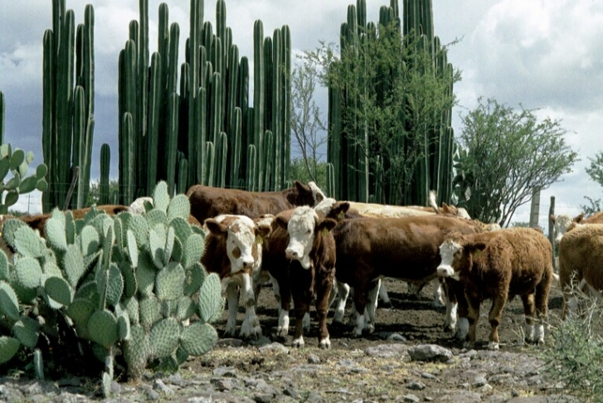
2006: 16th World Congress Calgary, Canada (for the 2nd time)
New Presidency:
Franz Stürzer, DE
Josef Kucera, CZ
Bruce Holmquist, CAN
2005: committee meeting in Guadalajara, MEXICO
Topics:
New developments in DNA technology
Beef production and the importance of Simmental cattle
Global agriculture and livestock farming in transition
First international young breeder program went well

Slide 21
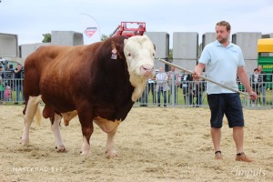
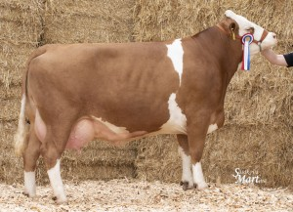
2007: Committee meeting in the Czech Republic
Hosted: R. Sustacek (died 2016) and Josef Kucera
Topics:
Budget for research projects
Health monitoring and breeding for fitness (Egger-Danner, AT),
SIM-FV under extensive conditions (Massmann, SA)
Fleckvieh-Past-Present-Vision (Grupp, DE)
Simmental cattle in China - officially recognized as a breed (Yachun Wang)
Netherlands: Fleckvieh-Stamboek founded - 100 members

Slide 22
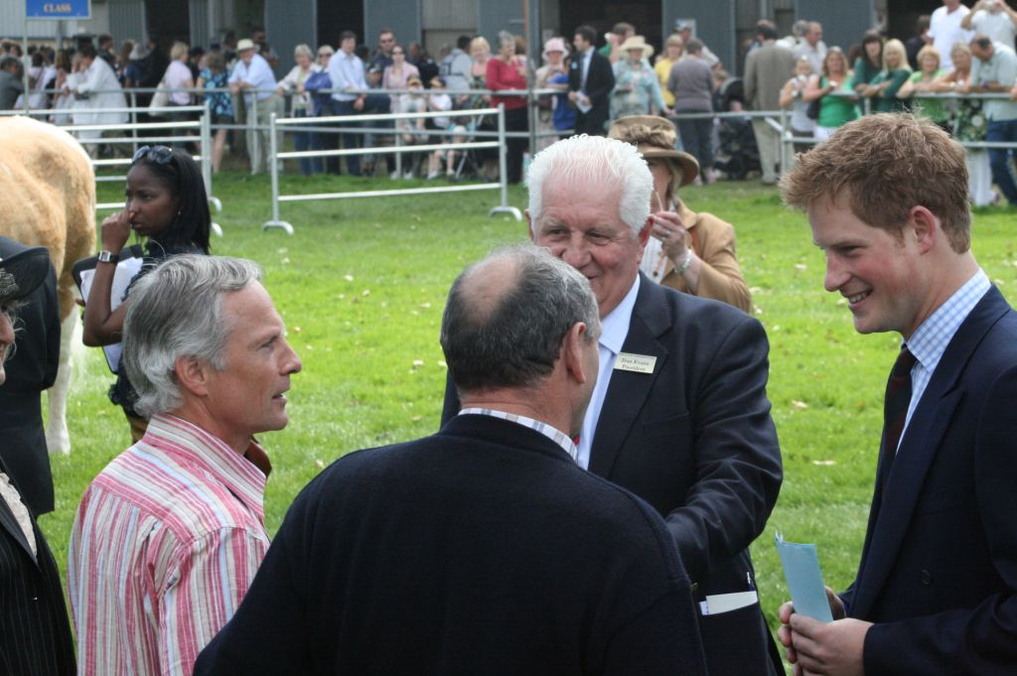
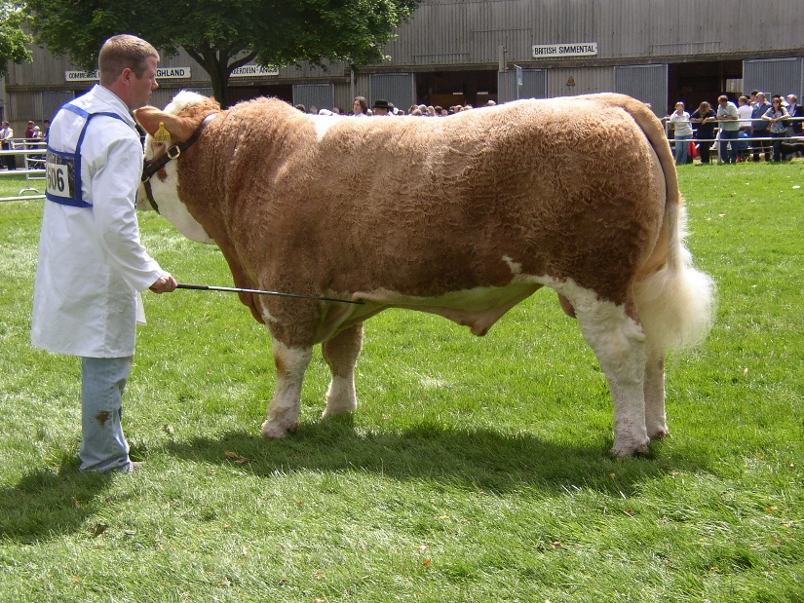
2008: 17th World Congress Huntingdon, Great Britain
New Presidency: Bruce Holmquist, CAN; Josef Kucera, CZ; Bill Almond, AUS
Czech Republic takes over the General Secretariat (Kristýna Skopalova)
Topics:
Beef tenderness as a quality characteristic
DNA - use in breeding programs
Hereditary defect spider limb (arachnomelia)
The WSFF invites the young breeders' associations to participate.
H.E. Prinz Harry with Dan Evans, Georg Röhrmoser, Franz Stürzer

Slide 23
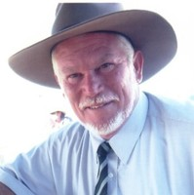
2010: 18th World Congress Melbourne, Australia
Hosts: Bill Almond and
Peter Speers
Topics:
SIMBRA Breeding
Harmonization of conformation
Genome projects in North America and Europe
Interbeef breeding value estimation

Slide 24
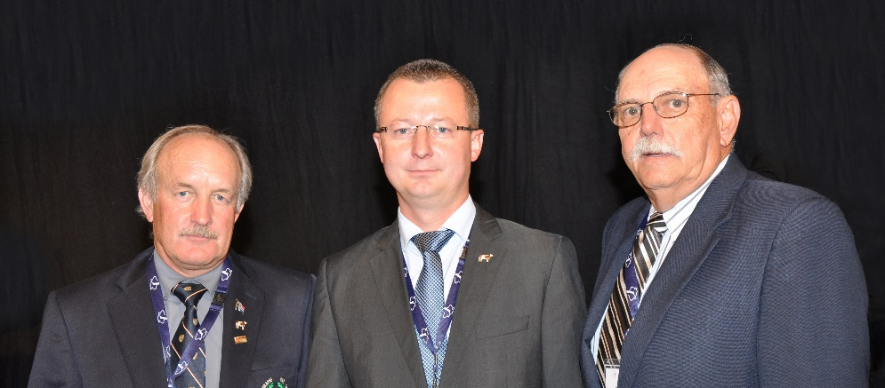
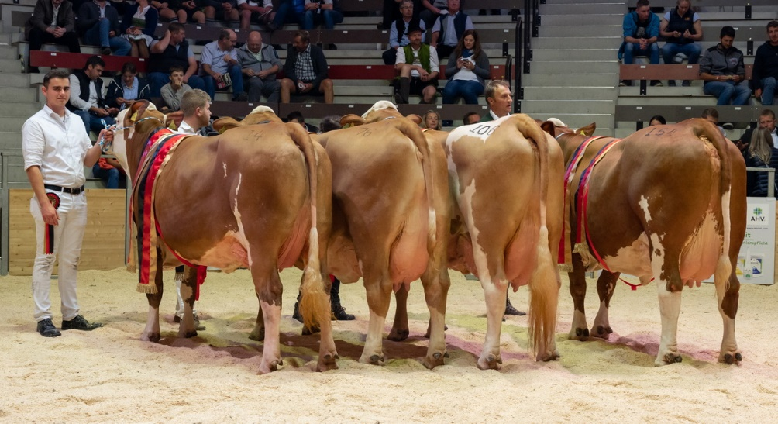
2012: 19th World Congress Germany 28 member countries, 350 participants from 28 countries
New Presidency: Johann Kluyts, SA;
President: Josef Kucera, CZ; Fred Schütze, USA;
Topics:
Genomic selection in DE+AT+CZ
Beef performance in dual purpose and suckler cow breeding
The robust Simmental cow - fitness and health
SIMBRA - The best of 2 breeds (Reini Rush, NAM)

Slide 25
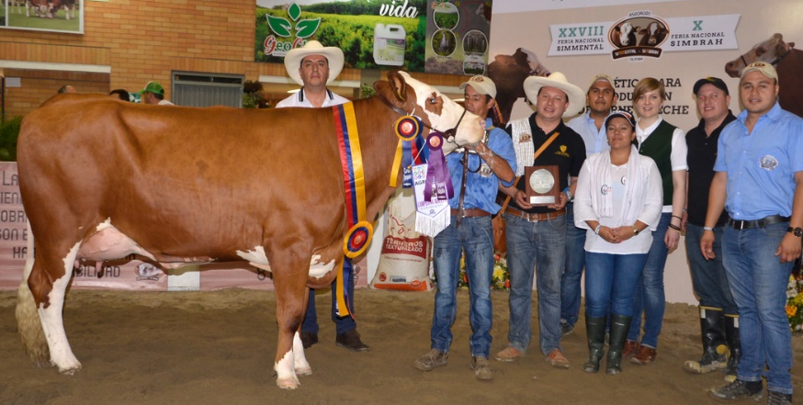
2014: 20th World Congress Cartagena, Colombia
Topics:
Scientific developments, ICAR, standardization of breed codes and codes for hereditary defects
Genomic selection project Gene2Farm
Conformation classification “System 1997“ to „FleckScore“ in 10 European countries
Discussions on better integration of WSFF with EVF and ASA
2013: Croatia celebrates 100 years of Simmental cattle breeding

Slide 26
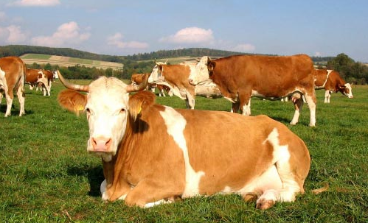
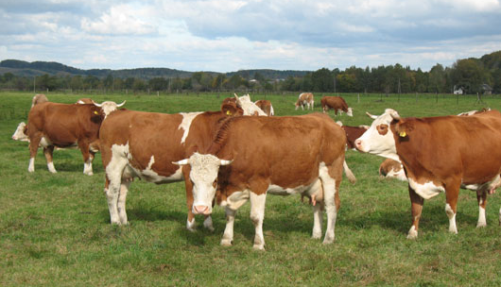
2016: 21st Weltkongress Krakau, Rzeszow, Rudawka Rymanowska, Polen
New Presidency:
Fred Schütze, USA; Sebastian Auernig, AT; Peter Wenn, AUS
2015 in CH: Adoption of a decision to reform the WSFF statutes
Topics:
SIM-FV breeding in Poland
Dual purpose always modern
Use of genomic information

Slide 27
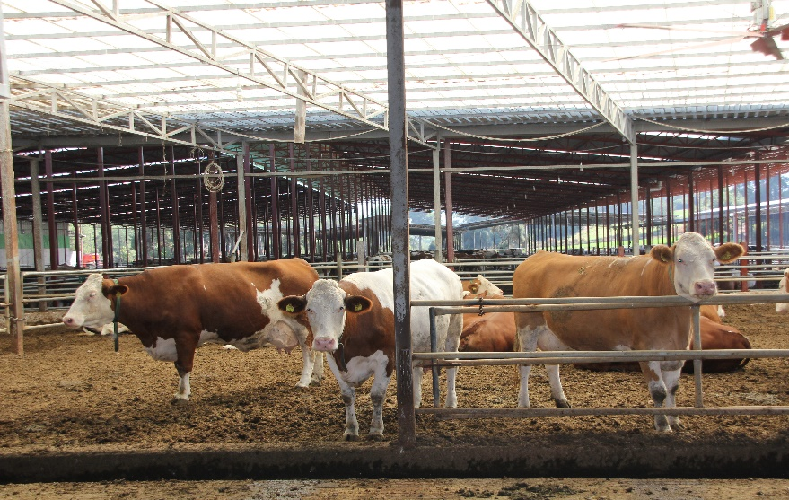
2017: WSFF conference in the new member country Turkey
Topics:
Simmental Fleckvieh in Turkey” (Celik, TK)
The breed has been around since 1925. 70,000 Si-Fv imports in recent years
Tracking down the efficient Simmental cow (Steininger, AT)
Developments and successes of the Simmental in Canada (Holmquist)
Fleckvieh Herde in der Türkei, Gebiet Izmir

Slide 28
2018: 22nd World Congress Texas, USA
Topics:
Design of BOLT for Multi-Breed
SINGLE STEP methods and evaluation
Searching for cows for consistent production assurance “Make Money for Ranger”
Genomic tests on embryos
ET and IVF on young cattle on nucleus stations
Development of local and global databases for genetic evaluation

Slide 29
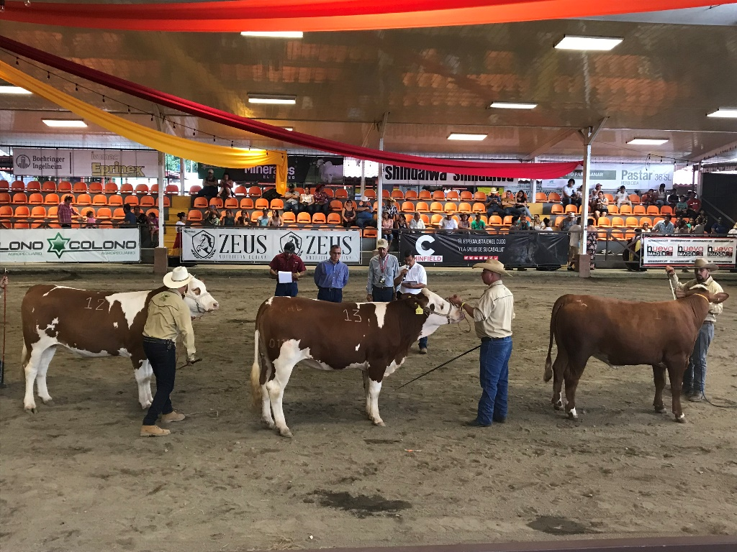
2019: WSFF Board of Directors in Costa Rica
As part of the 3rd SIM Congress of the Americas
Topics:
Communication and breed promotion
Improvement of online information
Homepage and WSFV/EVF newsletter updates

Slide 30
2020/2021 Worldwide corona pandemic
The 23rd World Congress in Austria first had to be postponed to 2021 and then again to 2022.

Slide 31
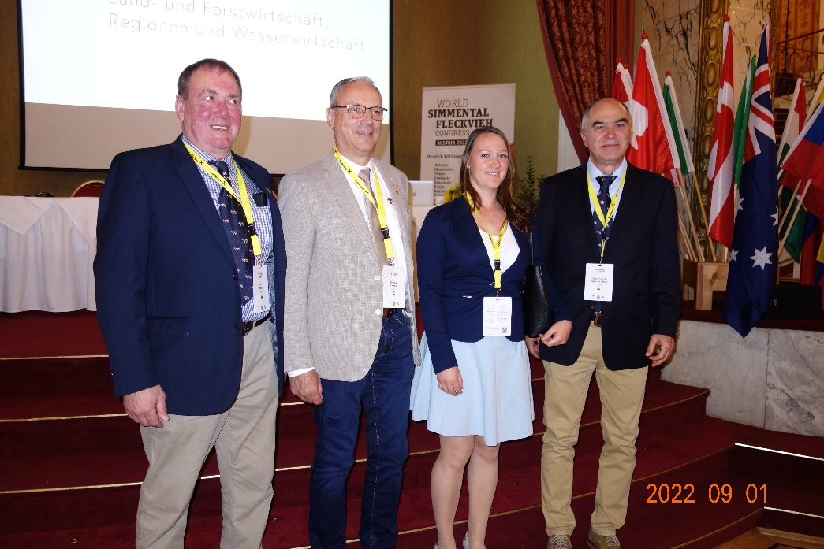
2022: 23rd World Congress in Austria
New Presidency:
Peter Wenn, AUS; Sebastian Auernig, AT; New Secretary General: Blanka Dřízhalová, CZ; Daniel Espinosa, COLUMBIEN
Bulgaria rejoins the WSFF after many years
Topics :
Simmental cattle of the future - from traditional breeding to genome editing
Modern breeding programs for the future
Producing milk and beef sustainably with Simmental cattle
International developments in the breeding of Simmental cattle for beef production
The FV cow - (not) a climate killer?!

Slide 32
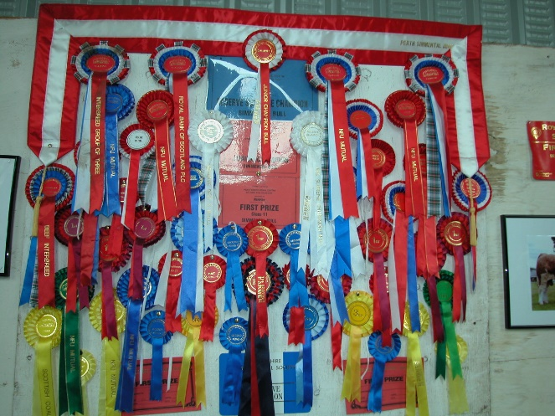
2024: 24th World Congress Calgary 50 years WSFF
D A N K E – T H A N K Y O U
Breeders, young breeders, breeding associations, working groups, insemination, testing and research institutes, veterinary experts, authorities, funding agencies and legislative bodies, both nationally and internationally.
Science and research for their irreplaceable work, e.g. genomics - a new era in animal breeding. High breeding progress, fitness and health. Selection simpler, faster, more cost-effective. Generation interval significantly shortened.
Export and import companies confronted with ever stricter animal transportation and animal welfare requirements.

Slide 33
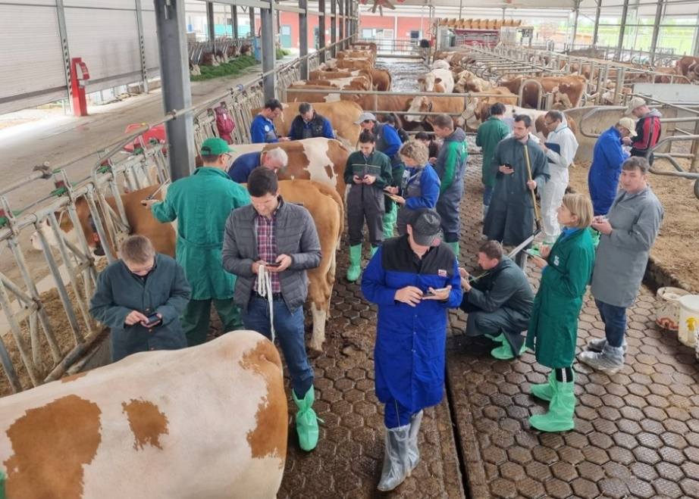
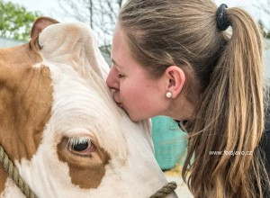
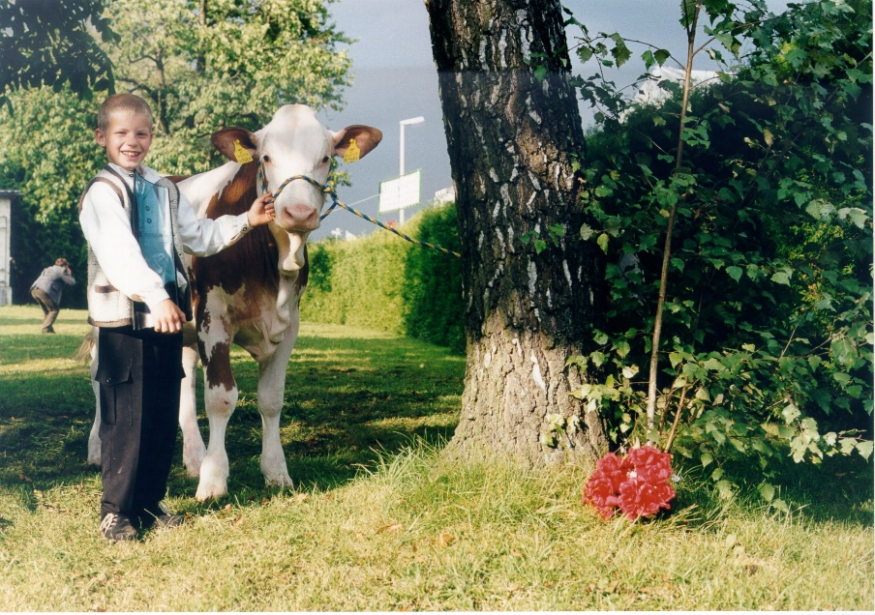
2024: 24th World Congress 50 years WSFF
Young Breeders' Delegations Round Table in Calgary -
WSFF sponsors the meeting

Slide 34
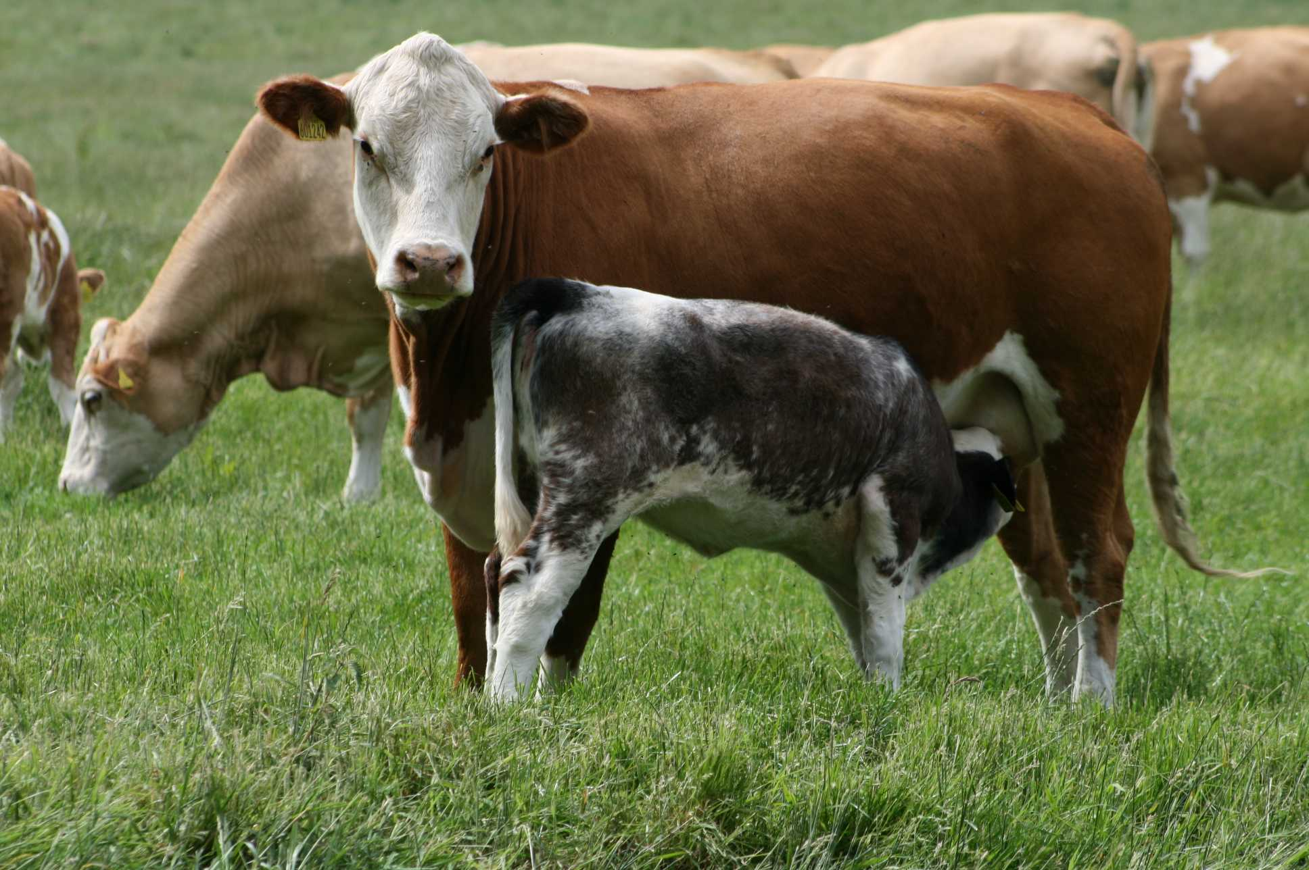
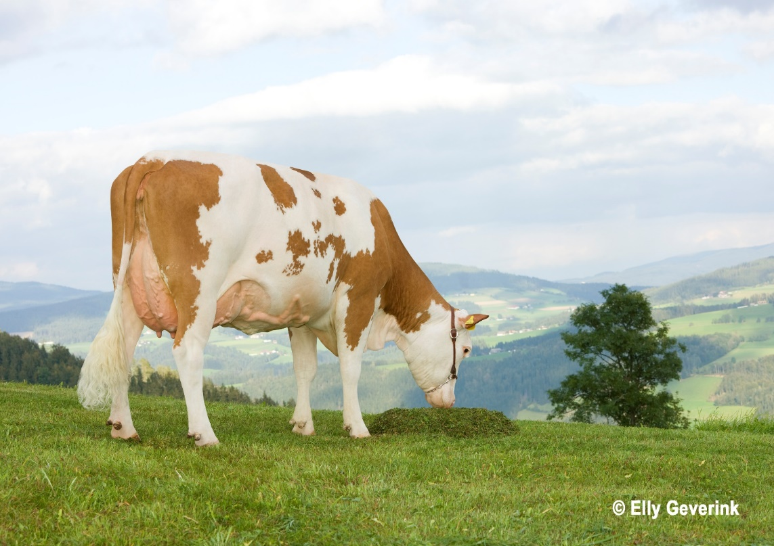
Let's look to the future:
Simmental Fleckvieh cattle are simply great
We breeders love this cattle - the best breed of cattle worldwide

Slide 35
Welt-Simmental-Fleckviehvereinigung 50. Geburtstag World Simmental Simmental Cattle Association 50th anniversary
Danke für ihre Aufmerksamkeit!
Thank you for your attention!

